Slide 1
Regional Customer Support Overview

Slide 2
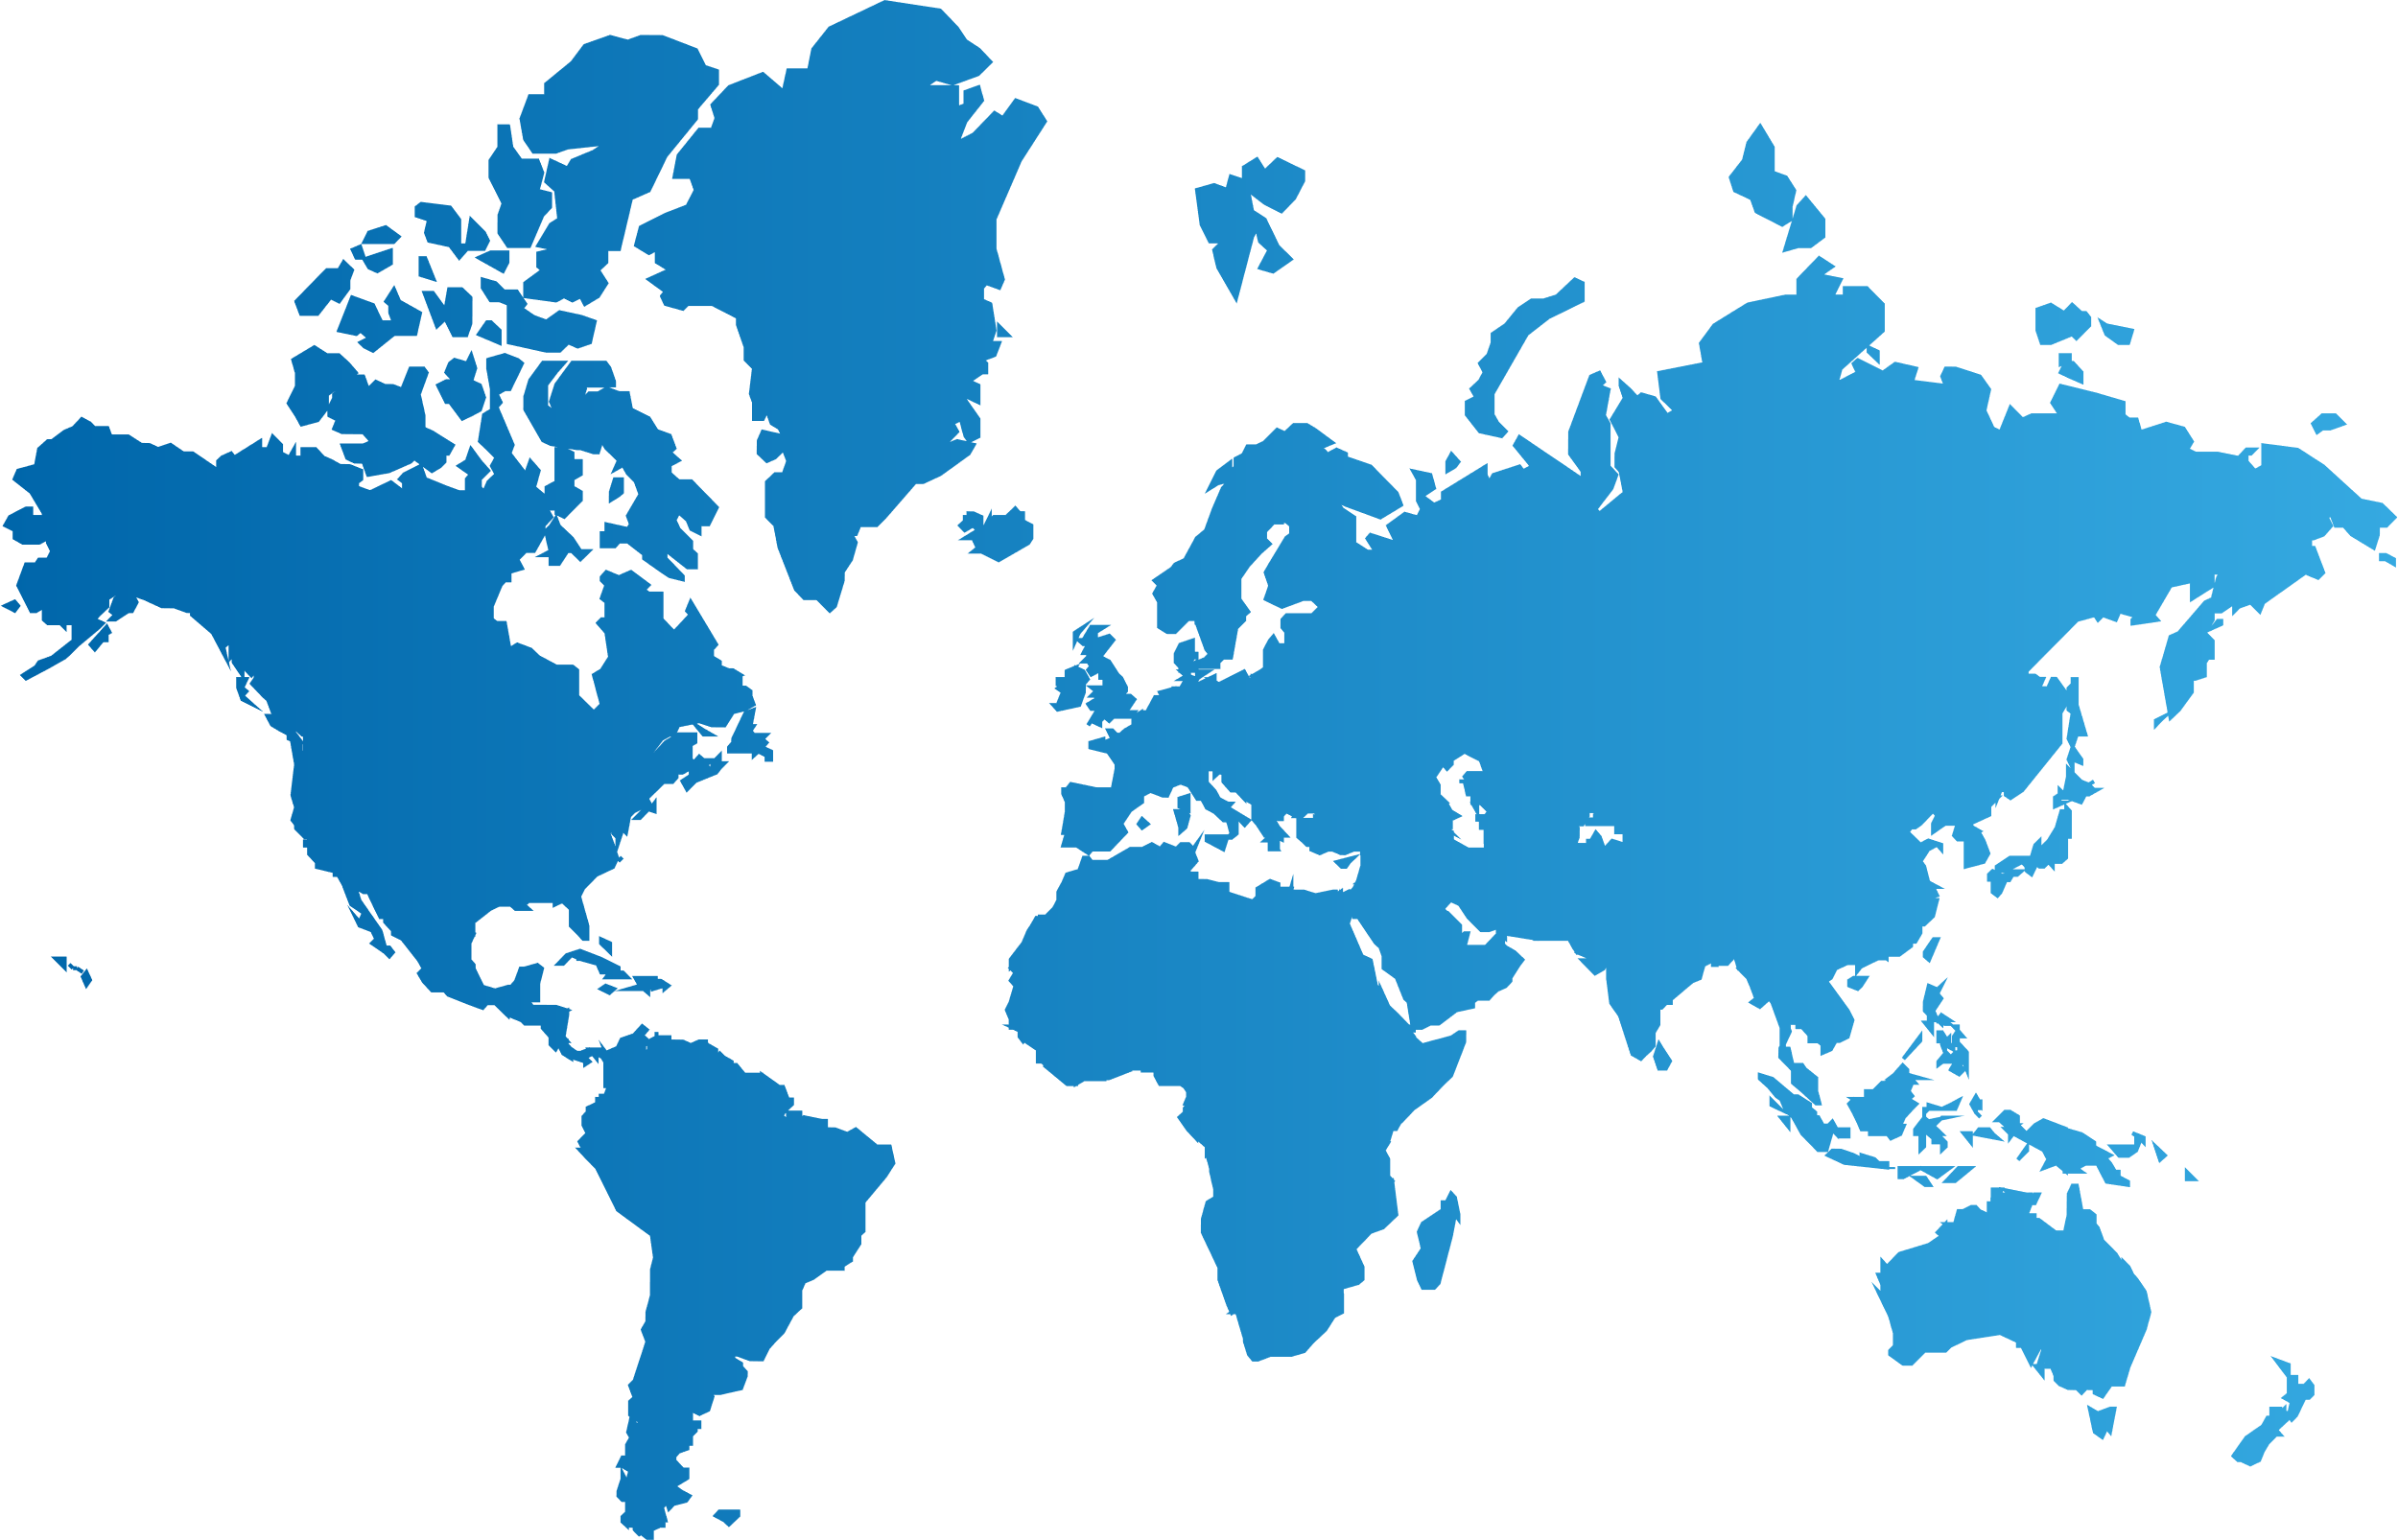
Present Where You Need Us
Our customer support
Stavanger/Stord Eik/Oslo
Rotterdam
Hamburg
Bratislava
Aussaguel
Palma
Athens
Houston
Tokyo
Dubai
Manila
NOC Maritime / Enterprise
Singapore
MNOC, IT and MSS
Regional Customer Support
Competence Center for IT, VAS, MSS
Service Management
Rio de Janeiro
Security Operations Center
Tier 1 Support for Petrobas

Slide 3
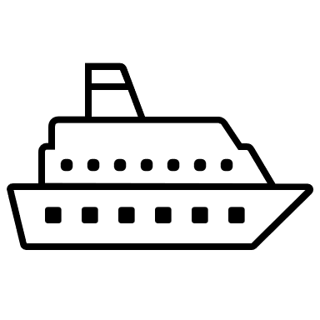
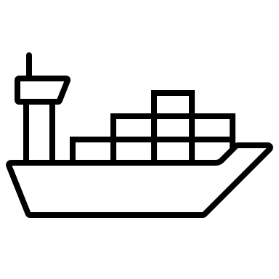
Previous Support Structure
Competence Center
Digital Solutions 3rd Line
Connectivity 3rd Line
MSS (Inmarsat/
Iridium)
IT Solutions
Network Operation Centers
Customers
Notes:
- too many contact points
- low synergy across the teams, need to pass a case among teams, e.g., connectivity doesn’t know IT setup
Common issue with providers, Admin/technical

Slide 4

Regional Customer Support
Competence Center
Digital Solutions 3rd Line
Connectivity 3rd Line
Beyond a single point of contact
First level resolution
Incident ownership
Know your vessels
Network configuration and IT policies
Closer to your team
Regular review
MSS (Inmarsat/
Iridium)
IT Solutions
Network Operation Centers
RCS / Tech Support
– Singapore, Tokyo, Dubai, Houston, Bratislava, Athens / Mumbai
Customers

Slide 5
Closer to Our Customers
Notes:
Global company, regional teams

